Slide 1
Paintball Environment Tactical Engagement Recon System (P.E.T.E.R.S.)
Group Number: BCC-4
Richard Taylor – C.E.
Anthony (AJ) Schmidt – E.E.
Kenneth Hale – E.E.
Brett Reich – C.E., E.E.
Antonio Foster – E.E.
Advisor
Dr. Christopher Peters – E.C.E.
May, 2016 – Spring Quarter
Notes:
Team Introductions

Slide 2
Presentation Outline
Problem Statement
Proposed Solution
Electrical Schematics
Standards
Team Member Responsibility
Societal Impact
Budget – Out of Pocket
Testing and Validation Results
Demo Video
Notes:
Antonio

Slide 3
Problem Statement
Our research indicates that there is currently no single product available that addresses all of the most common distractions that a player faces while playing the game of paintball.
Teammate location
Air pressure remaining
Paintballs remaining
We utilized various sensors, a display, and a communication network to develop a single system which alleviates these distractions.
Notes:
Ken

Slide 4
Proposed Solution
A system consisting of the following:
Honeywell Pressure Sensor mounted to air tank regulator
Collects real time data on available pressure in tank
Hopper with Ultrasonic Sensor System
Monitors available paint levels in hopper
Arduino Pro Minis with XBee Dongles
Wirelessly transmit data from sensors to server
Raspberry Pi 2 with Wi-Fi/XBee Dongles
Processes data
Share data between users
Recon Snow2 Heads Up Display (HUD)
Displays Information to the user
Transmits user GPS data to the Raspberry Pi
Notes:
Basically read slide
AJ

Slide 5
Proposed Solution – Block Diagram
Notes:
This slide shows the basic overview of how our system will work. Solid lines indicate wired connections, while dashed lines indicate wireless communications. In the top left you’ll see the pressure sensor. The pressure sensor is hardwired directly to the Raspberry Pi which is the central point for data processing and communications. Below the pressure sensor in the bottom left is the break-beam sensor circuitry. This will also be hardwired to the Raspberry Pi but has an optional wireless connection in which sensor data can be sent to the Raspberry Pi wirelessly by an Arduino board. In the top right, you’ll see the Snow2 HUD. This Snow2 HUD will communicate with the Raspberry Pi wirelessly and bi-directionally. It will receive visual information such as maps and alerts from the Pi and will transmit GPS information back to the Pi.
AJ

Slide 6
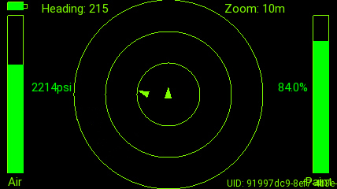
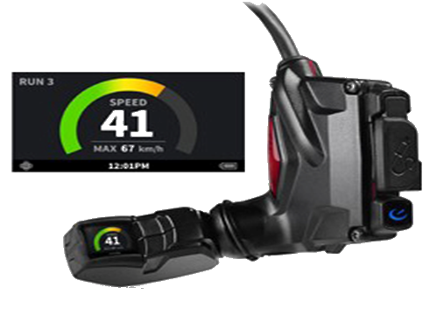

Proposed Solution – HUD GUI
Notes:
Rick
“Depicted here is a screen-capture of the GUI display that will be projected onto the HUD; this is the current iteration of how the data pertinent to the user will be displayed. The amount of air remaining in the user’s tank is depicted in the bar graph on the left, relative teammate position is indicated in the ‘scope-view’ in the center, and the amount of paintballs remaining in the loader is depicted in the bar graph on the right.”

Slide 7
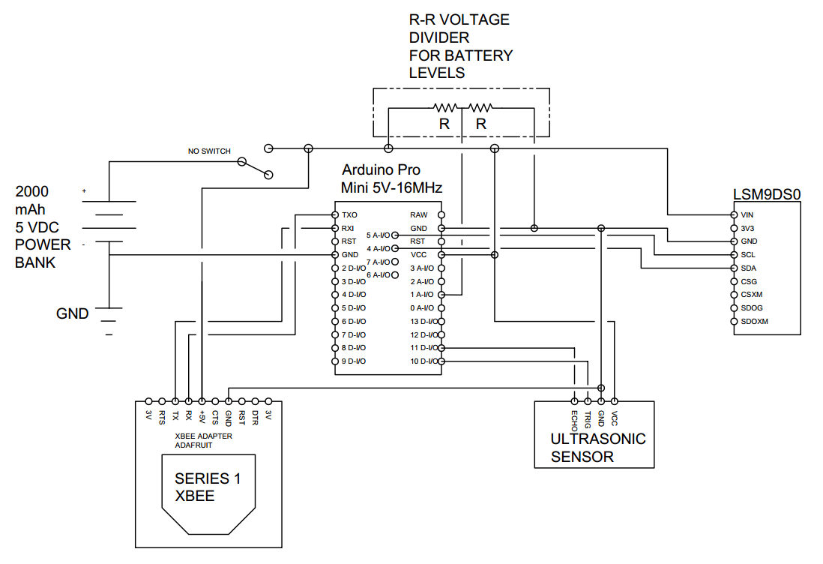
Electrical Schematics
Paintball Hopper Schematic
Notes:
Antonio

Slide 8
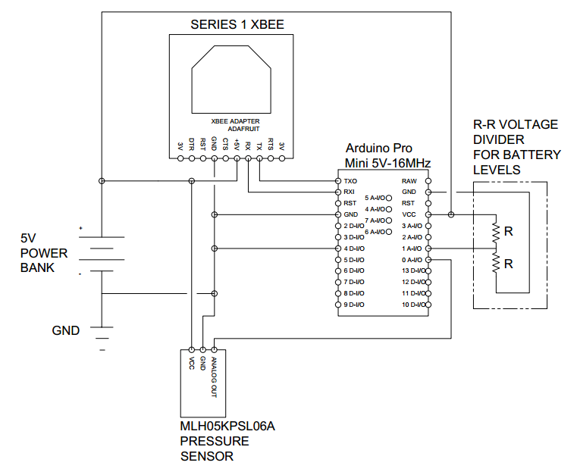
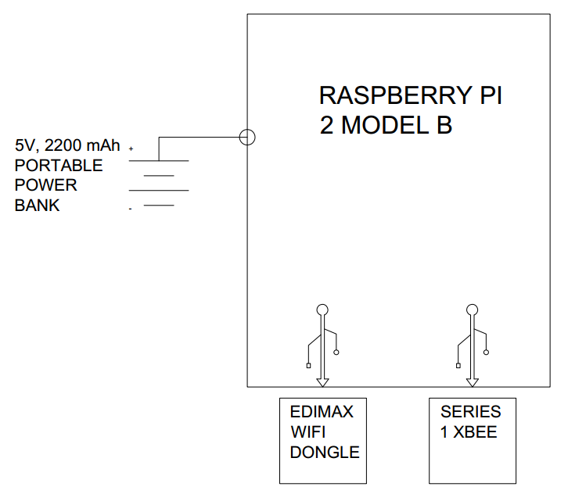
Electrical Schematics
Compressed Air Tank Schematic
Raspberry PI Schematic
Notes:
Antonio

Slide 9
Background Research - Standards
Standard ECMA-404 (JSON Data Interchange Format)
Standard IEEE 802.11 – Wi-Fi
Standard IEEE 802.13 - ZigBee
Standard IEEE 802.15 - Bluetooth
EPA regulation 40 CFR 273.13(a) (Waste management requirements for small quantity handlers of universal waste batteries)
Notes:
“Ken” - "Listed here are a few standards that were considered as applicable to the PETERS project. This Includes standard ECMA-404.(JSON data interchange), This is how we communicate to and from our Raspberry Pi and its peripherals.
Then there are IEEE 802.11 and 802.15 which cover Wi-fi and Bluetooth respectively. However because we are only using off the shelf wireless devices, these standards are already satisfied.
Because The Snow2 uses a lithium Ion battery, another applicable standard is EPA regulation 40 CFR 273.13(a). This standard talks about the proper handling of batteries and how they must be sealed and non-leaking at all times.

Slide 10
Team Member Responsibility
Member | Individual Contributions to the Project
Richard Taylor | HUD GUI application code • Database and communication server code Xbee communication
Brett Reich | Database and communication server code Sensor array data gathering/processing code HUD GUI application code
Kenneth Hale | Sensor array data gathering/processing code • Arduino to PI communication Accelerometer filtering • Prototype manufacturing Assist in 3D modeling
AJ Schmidt | 3D modeling for prototype • Ultrasonic sensor feasibility analysis XBee communication testing • Sensor data collection coding Prototype manufacturing
Antonio Foster | 3D modeling for prototype • Ultrasonic sensor feasibility analysis Sensor data filtering • Sensor data collection coding Prototype manufacturing
Notes:
Ken

Slide 11

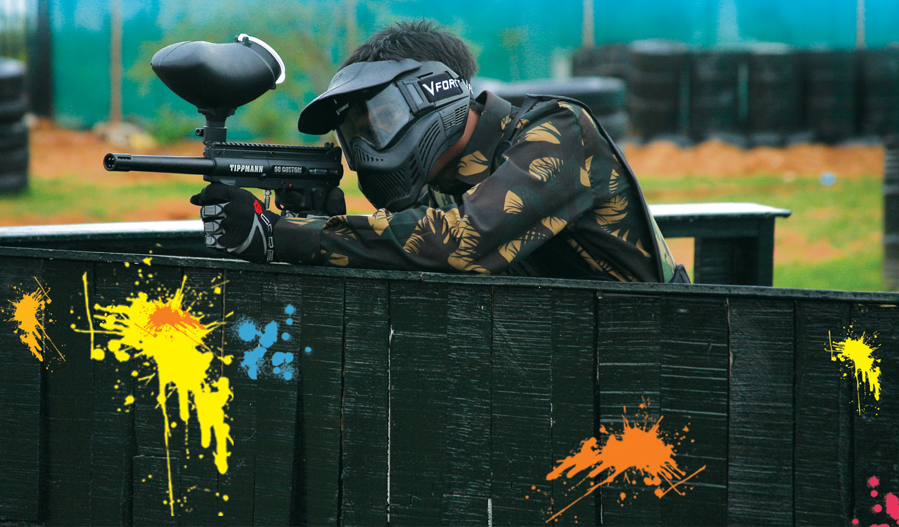
Societal Impacts
Targets existing players and large gaming community
Potential to get thousands of people out of the house and be more active
Possible Integration into Civil Service/Military Applications
Notes:
"Project PETERS is currently targeted at all paintball players and the existing large gaming community. We hope that by changing the dynamic of the game it will relate more with this community and encourage people to become more active. There is also the obvious possibility for future civil and military applications. For example, with some tweaks to the system, project PETERS could be suitable for EMTs, fire fighters, or the police. These are all jobs where knowing the location of your team can be a life and death situation"
Ken

Slide 12
Work Schedule / Timeline
Planned
Actual
Notes:
Rick

Slide 13
Budget – Out of Pocket
Model Name | Unit Cost | Units | Sub-total
AA Battery Pack | $19.49 | 2 | $38.98
Micro-Bluetooth 4.0 LE | $8.99 | 2 | $17.98
Micro-SD 16GB (Sony 70Mb/s) | $8.99 | 2 | $17.98
CanaKit Raspberry Pi 2 + case | $46.99 | 2 | $93.98
SNOW2 (HUD only) | $399.00 | 2 | $798.00
MLH05KPSL06A – Pressure Sensor | $146.14 | 2 | $292.28
Photo-Resistor (20pcs) | $4.69 | 1 | $4.69
SNOW2 (HUD + Goggles) | $549.00 | 1 | $549.00
Laser Diode (5 pcs) | $3.54 | 1 | $3.54
Edimax EW-7811Un Wi-Fi Adapter | $9.99 | 2 | $19.98
Female / Male / Male 1/8th | $36.47 | 1 | $36.47
Shipping (for goggles) | $54.99 | 1 | $54.99
Arduino Pro Mini | $20.00 | 2 | $40.00
Adafruit 9-DOF LSM9DS0 | $20.49 | 1 | $20.49
 |  | Total | $1,988.36
 |  | Per Person | $397.67
Notes:
This is how much we’ve spent on the project so far. Our total cost comes to about $1900 total with each person spending around $385. The most expensive items were the Snow2 HUD and the pressure sensors.
AJ

Slide 14
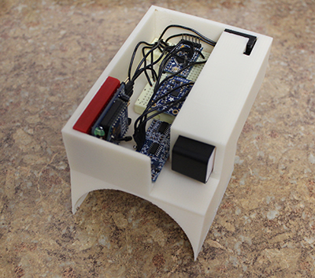
Testing & Validation – Unit Testing
Hopper Mount Assembly
Ultrasonic distance sensor
Calibrated sensor outside hopper
Calibrated in hopper with varying paint levels
Smoothed sensor data
Accelerometer
Battery drain testing
16.6 hours processing/transmitting
21.2 hours processing/ NO transmitting
Notes:
AJ

Slide 15
Testing & Validation – Unit Testing
Air Tank Mount Pressure Sensor Assembly
Analog readings vs Digital readings
PSI/Voltage testing
Battery drain testing – 37.2 hours processing/transmitting
Circuitry validation
Battery drain issue
Notes:
Antonio

Slide 16
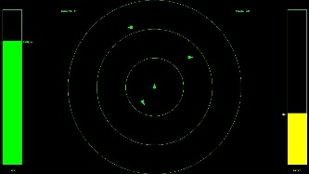
Testing & Validation – Unit Testing
Heads-Up Display (HUD) Application
Determined type/resolution of data returned from GPS
Simulated data processing/rendering with ‘virtual’ users
Is everything displayed as it should be?
Message handling/dispatching
Correct handling of incoming messages and associated data
Correct message dispatching with appropriate data
Position update contention testing
User interaction
Zoom level
User ID selection
Notes:
Rick

Slide 17
Testing & Validation – Communication Testing
Server socket contention resolution
Automatic reconnection verification
Next-server fallback testing
Invalid input handling
Timeout handling
Self-testing tool suite for network messaging primitives
Notes:
Brett

Slide 18
Testing & Validation – System Testing
Field testing
Repetition to verify data consistency
Air pressure and paint level data
Screen capture utility (Android Debug Bridge & tablet)
Allowed us to reference screen captures
Player position verification
Logged player position
Walking
Running
Driving
Compared logged latitudes/longitudes with real-world locations
Notes:
Brett

Slide 19
Testing & Validation – Results
All data successfully displayed on the HUD module
Air data and paint level data are accurate
Air data is direct tank reading
Paint level data sufficiently processed
Positional data is partially reliable
User GPS data verified to be within 1 to 5 square meters of actual real world position
Heading data from GPS module is UNUSABLE for this application
Relies totally on motion to update
Extremely slow to update
This system will require a functioning INU for proper user location determination
Notes:
Rick

Slide 20
Demo Video

Slide 21

Questions

Slide 22
Supplemental Slides To Follow

Slide 23
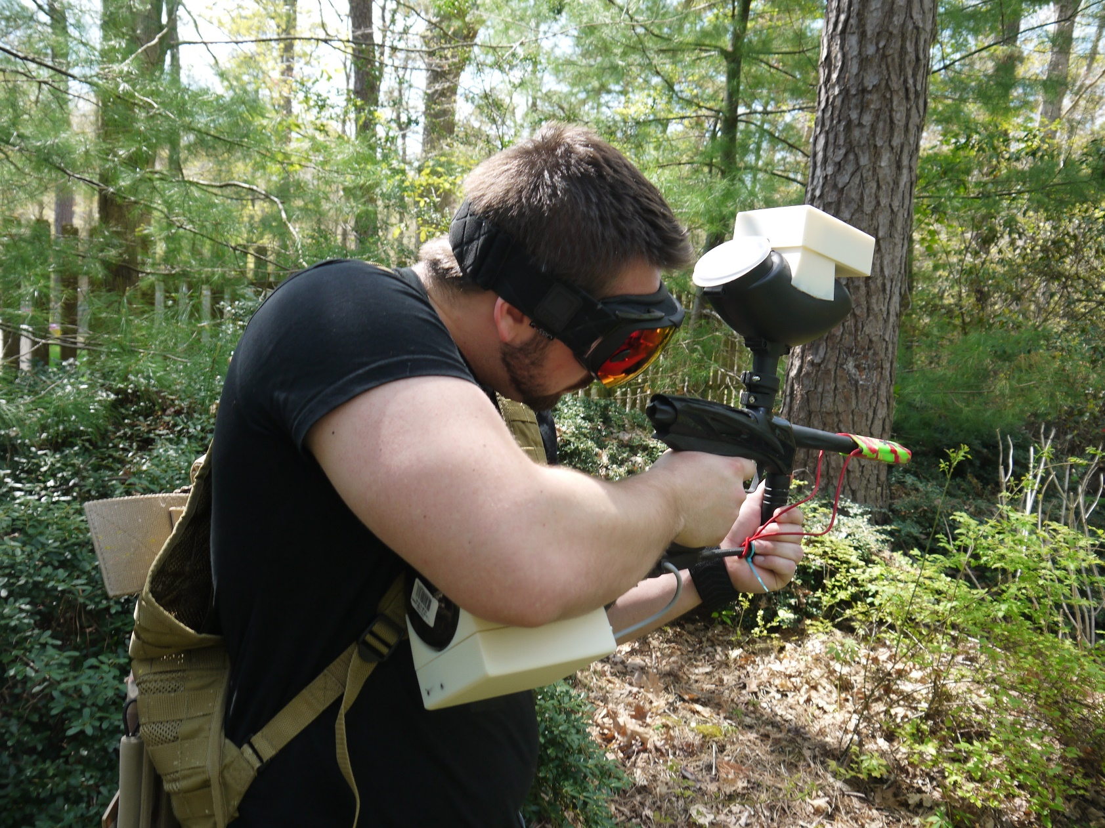
Typical User Setup

Slide 24
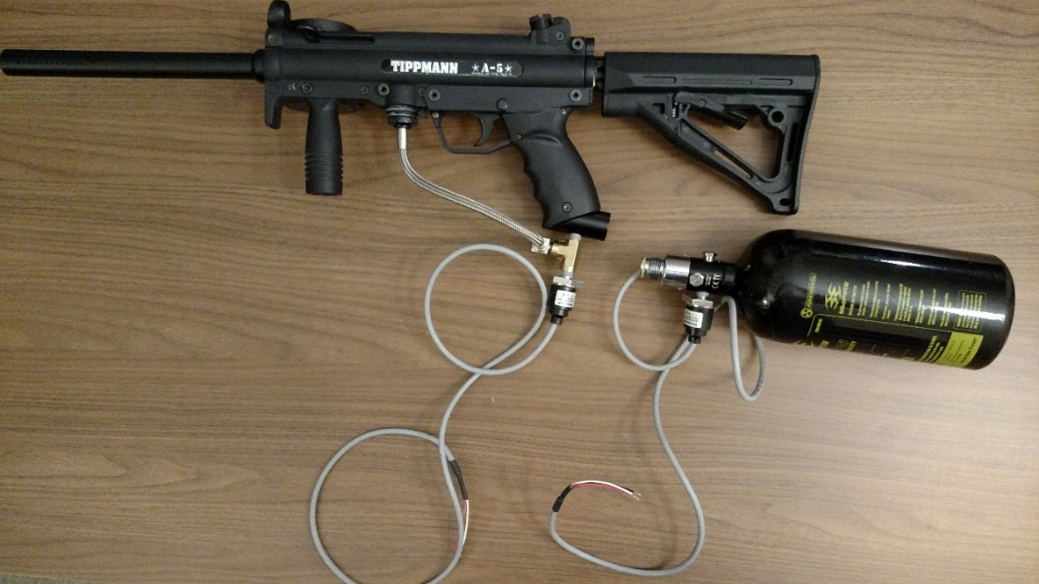
Fall Progress – Hardware
All equipment purchased and acquired
Honeywell Pressure sensor mounted and tested in 2 locations
Gathered important data using Arduino
Preliminary Break Beam Feasibility Test Completed
A
B
A – Pressure Sensor Mounted on Marker
B – Pressure Sensor Mounted on Tank
Notes:
Antonio

Slide 25
Fall Progress - Software
Base classes for GUI display framework
Moving Map Overlay
Utility classes (i.e. Latitude/Longitude to Pixel Position)
Supplemental classes (i.e. overlay constructors, icons, alert formatting, etc.)
Air Tank Readout and Paint Level Overlay
Python Application Packaging for Android
Basic network framework
Communication of JSON formatted messages
Data Collecting Utility
Gathered important data from Pressure Sensor
Paint detection algorithm
Notes:
Rick
“During the fall term, all of the base Python classes to be used as a framework to create the GUI display for the HUD were laid out; these classes were to form the basis for what is now a fully functioning GUI display. The utility classes and constructors were also created to support generation of the individual GUI components. In addition, a process for packaging Python applications for utilization on an Android platform was created. This process relies on third-party Kivy software utilities and formats the entire Python GUI application into an appropriately structured Android executable.”
Brett

Slide 26
Winter Progress – Hardware
Paint Level Detection System (Completed)
Components:
Accelerometer/Gyroscope – Track orientation of marker so only meaningful data is used
Ultrasonic Sensor – Measures current paint level in user’s hopper
Arduino Pro Mini – Microcontroller to collect data from sensors
XBee – Wireless serial communication with server
Battery – Removable and rechargeable USB 5V power bank
Compressed Air Level Detection System (Model nearing completion)
Components:
Honeywell Pressure Sensor – Measures current air pressure remaining in user’s tank
Arduino Pro Mini – Microcontroller to collect data from sensor
XBee – Wireless serial communication with server
Battery – Removable, rechargeable USB 5V power bank

Slide 27
Winter Progress - Software
Estimated Data Rate Requirements:
MCU ->Sensor: s * [148, 15]
Sensor ->Server: [735, 12]
HUD ->Server: [18 + n*18, n*738]
Pos (HUD) ->Sensor: [220, 17]
Each Server ->Server: [18, 735]
MCU
Sensor
Server
External
Server
Significant Numbers:
Localhost Combined: 747
Node Internal Serial: s * [163]
Node Internal Socket: [984] + n * [753]
All External Socket: n * (n-1) * [753]
Total: n * 984 + (n*n) * [753] + n * s * [163]
Pos(HUD)
HUD
Key:
Rate Units:
[Up/Down] (Bytes/Sec) * (Refresh Rate)
Expansion Scaling:
s → Number of Serial Sensor MCU Node Per Node (Normally s=1)
n → Number of Nodes Total (Normally n > 1)
For Example:
n=5, s=1 Total: 23,810 bps
n=10, s=1 Total: 86,770 bps
Notes:
Brett

Slide 28
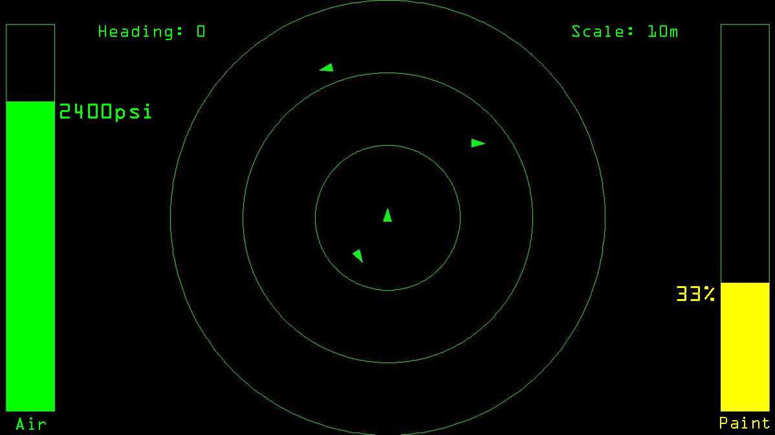
Winter Progress - Software
Break from previous design
Less-‘busy’ display
Tree cover
Implementation Time
Server Communications
WiFi
Air / Paint level
Teammate position indicator
Lat/Longs and headings
Haversine Formula
User’s heading and scope scale
GUI work is complete
In process of executing on HUD
Configure App permissions properly
HUD API Interfacing
Notes:
Rick
“For those of you who saw the previous iteration of the HUD GUI display, this current version will look a little different. The previous version of the HUD GUI displayed a satellite image of the actual playing field with the idea being that user icons would be plotted according to their actual location in reference to that satellite image. We decided to move in a slightly different direction in terms of how the display is configured. Since we are limited to a 428X240 resolution display, we don’t want to overload it with information and create a cluttered image; a satellite image from a suitable zoom level looks extremely muddled at this resolution. Since this display is to be referenced quickly in the field by the user, the information available should be presented in such a way that it is conveyed rapidly and doesn’t create another inadvertent obstacle for the user in terms of gaining a picture of his/her environment and equipment. In addition, many paintball fields are located in the woods under tree cover which really negates the usage of a satellite image. Also of concern was the amount of time it would take to actually implement a dynamic map-data download and distribution utility; we felt it may take too much time to implement this utility and so its been paused at least until we have full system integration. In terms of what is actually displayed on the GUI, on the left is a moving bar-graph representation of the air pressure remaining in the tank; this can display either in terms of a percentage of full or a PSI value. On the right is another moving bar-graph representation of the paintballs remaining in the loader; this will always display in terms of a percentage of full. In the center of the display is the teammate position indicator. The wearer’s icon is always located dead center and pointing straight up in reference to the GUI so that the wearer can always determine teammate location in terms of the direction he/she is facing currently. Teammate icons will be plotted around the wearer’s icon with their distance and bearing from the user being determined by their respective latitude and longitude coordinates. In addition, their respective headings relative to the current heading of the wearer are also displayed as the direction the icons are pointing. The plotting is done via utilization of the Haversine formula for calculating great circle distance between two points. The wearer’s compass heading and the current scale of the view are also both given. In addition to this, the GUI receives all of its required sensor and user information from the server via a WiFi network connection. Currently, the remaining task is to actually execute the GUI on the HUD; the tricky part will be dealing with the network operations permissions required for the device.

Slide 29
Spring Progress - Hardware
Solidworks 3D Model of Air Tank Attachment
Realized Air Tank Attachment with Circuitry

Slide 30
Addressing Comments
“Is it possible that the P.E.T.E.R.S. could be utilized for malicious purposes?” (Paraphrased)
Yes, but the same could be said for any piece of communication equipment
System would be useless to that end in its current state
Utilizes unencrypted transmission
Communication effected via a jammable, consumer WiFi network
“Design content of E.E. vs Design of Software should be explicitly stated”
Hardware design and circuit construction was simplified by heavy inclusion of COTS
Various electrical design considerations, nonetheless
Software to link all elements and display data is all custom designed and implemented
Notes:
Ken –
Now we move to addressing comments made from our fall presentation. One comment was: ““It is possible that the P.E.T.E.R.S. could be utilized for malicious purposes.” While this is technically true, the same could be said for any piece of communication equipment. However, our system, in its current state, would be useless to use for nefarious purposes
for the following reasons. Number 1, our system utilizes unencrypted transmission, and number 2, our communication runs on a jammable consumer wifi network.
The other comment we received from our fall presentation was “Design content of EE. Vs Design of Software should be explicitly stated” The majority of our hardware design and circuit construction was based on COTS, and therefore there was no real need to develop any additional electrical components. However, there were various electrical design considerations such as power consumption, data rate, and even size. It should be stated that all of the mounting hardware to accommodate the sensor array and the actual mount for the mask have all had to be designed and built. As well all of the software has been custom designed and documented. (Note: I think they want basically what are the E.E.’s responsible for and what are the C.E.’s responsible for)

Slide 31
Work Schedule / Timeline
Notes:
Included to show a more detailed timeline of the work to be done.

Slide 32
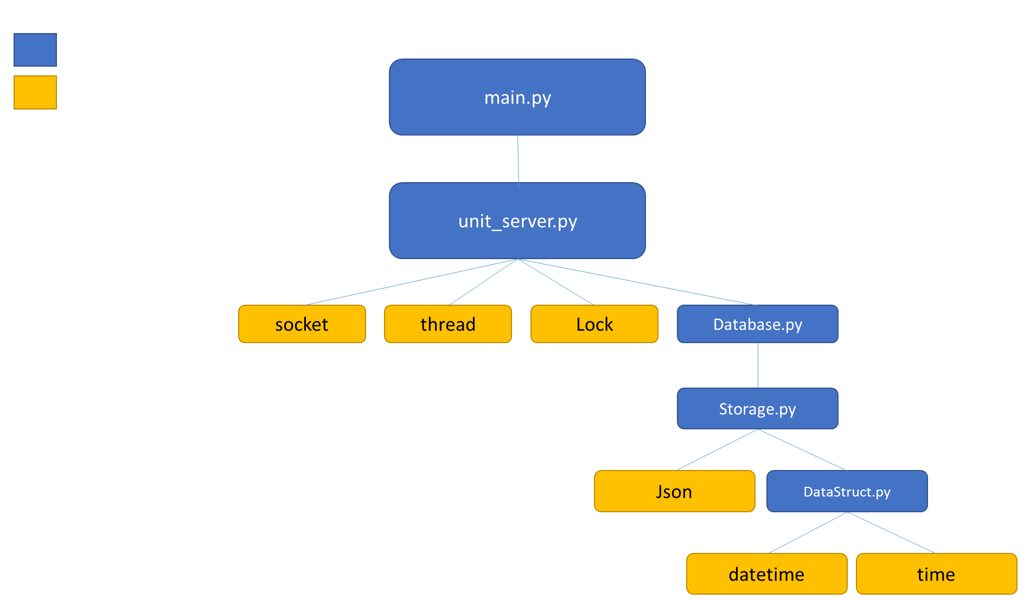

Slide 33
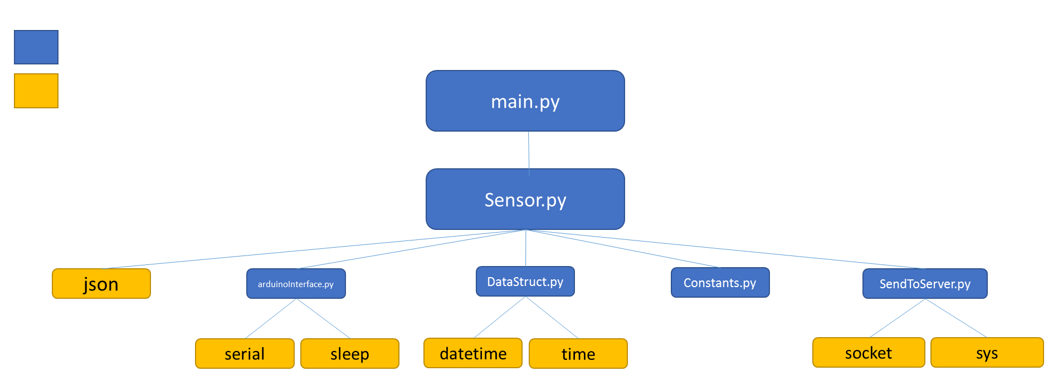

Slide 34
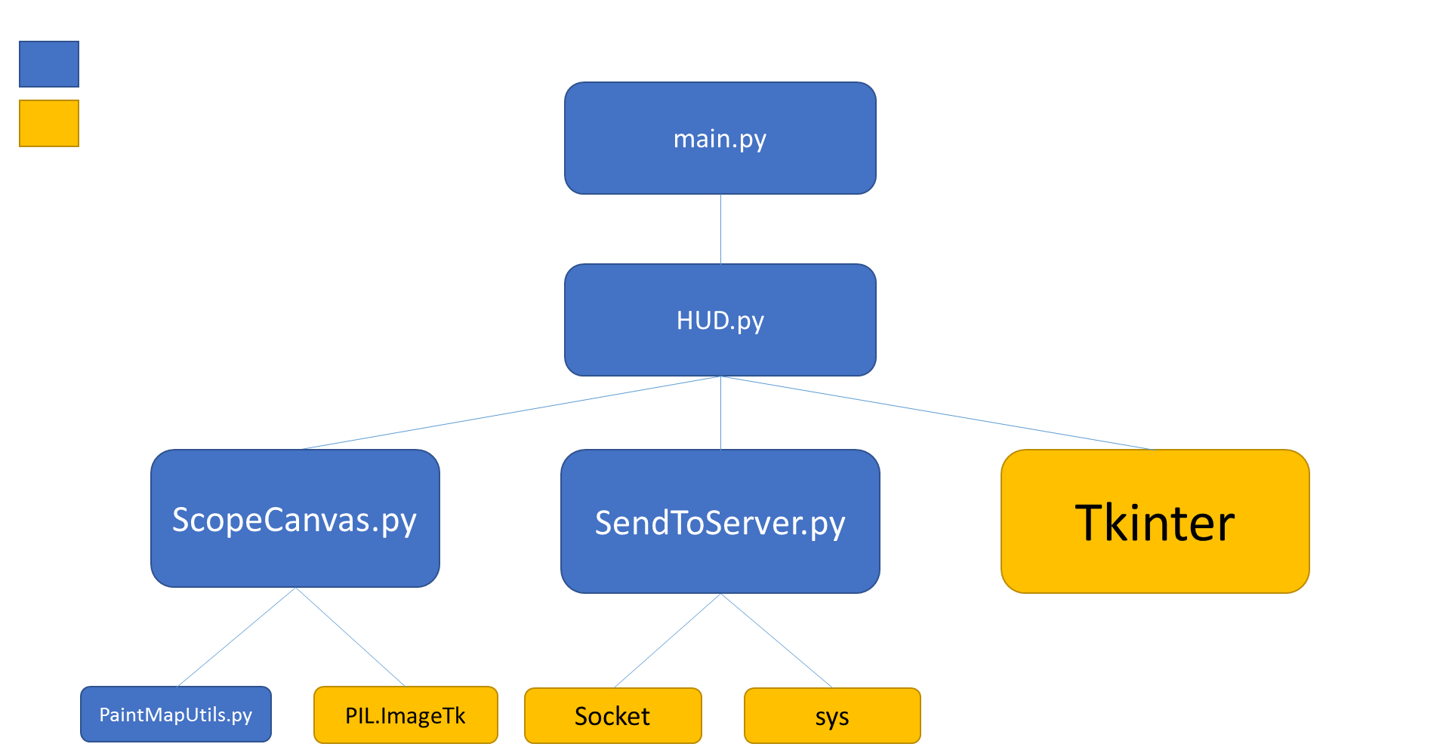

Slide 35
